Slide 1


Nathan Johnson
4/15/23

Slide 2
Outline
Executive Summary
Introduction
Methodology
Results
Conclusion
Appendix

Slide 3
Executive Summary
Summary of methodologies
Data Collection through API
Data Collection with Web Scraping
Data Wrangling
Exploratory Data Analysis with SQL
Exploratory Data Analysis with Data Visualization
Interactive Visual Analytics with Folium
Machine Learning Prediction
Summary of all results
Exploratory Data Analysis result
Interactive analytics in screenshots
Predictive Analytics result

Slide 4
Introduction
In the commercial space age, competition paves the way for innovation and data analysis creates opportunity. One such opportunity that has presented itself is Space Y, a new company built to compete with and ultimately surpass SpaceX. This project was created to capitalize on the mistakes SpaceX has made with the reusability of its first stage by understanding the optimum launch locations, booster version, and payload mass. I sought to understand and answer the following questions:
What is the ideal payload mass range for a successful rocket landing?
Is there a booster version that outperforms other versions?
Is there a launch location that outperforms other locations?

Slide 5

Section 1

Slide 6
Methodology
Executive Summary
Data collection methodology:
The data was collected from a SpaceX API and web scrapping from Wikipedia
Perform data wrangling
Filtered to only include Falcon 9 launches and null payload mass data values were replaced with the mean payload mass
Perform exploratory data analysis (EDA) using visualization and SQL
Perform interactive visual analytics using Folium and Plotly Dash
Perform predictive analysis using classification models
Used scikit-learn to build logistic regression, support vector machine, decision tree classifier, and k neighbor classifier to find best model

Slide 7
Data Collection
The data was collected using various methods
Data collection was done using get request to the SpaceX API.
Next, we decoded the response content as a Json using .json() function call and turn it into a pandas dataframe using .json_normalize().
We then cleaned the data, checked for missing values and fill in missing values where necessary.
In addition, we performed web scraping from Wikipedia for Falcon 9 launch records with BeautifulSoup.
The objective was to extract the launch records as HTML table, parse the table and convert it to a pandas dataframe for future analysis.

Slide 8

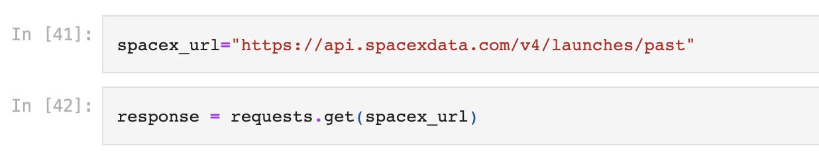
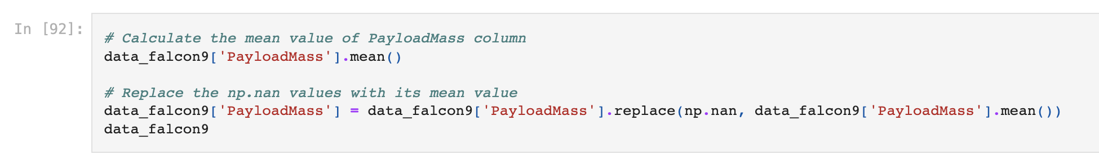
Data Collection – SpaceX API
We used the get request to the SpaceX API to collect data, clean the requested data and did some basic data wrangling and formatting.
Github Link

Slide 9
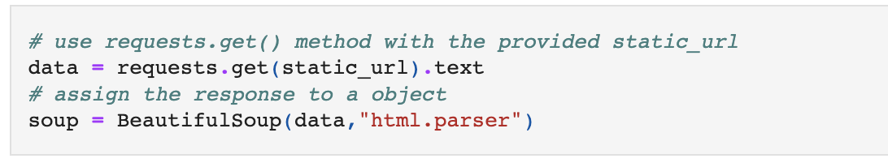
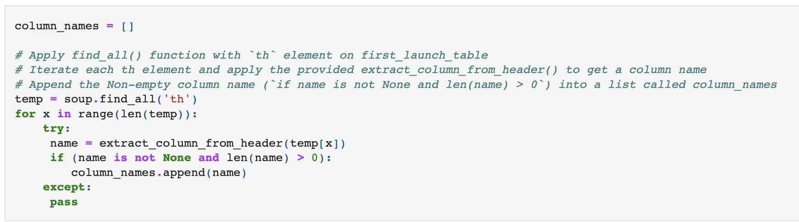
Data Collection – Web Scraping
We applied web scrapping to webscrap Falcon 9 launch records with BeautifulSoup
We parsed the table and converted it into a pandas dataframe.
Github Link

Slide 10
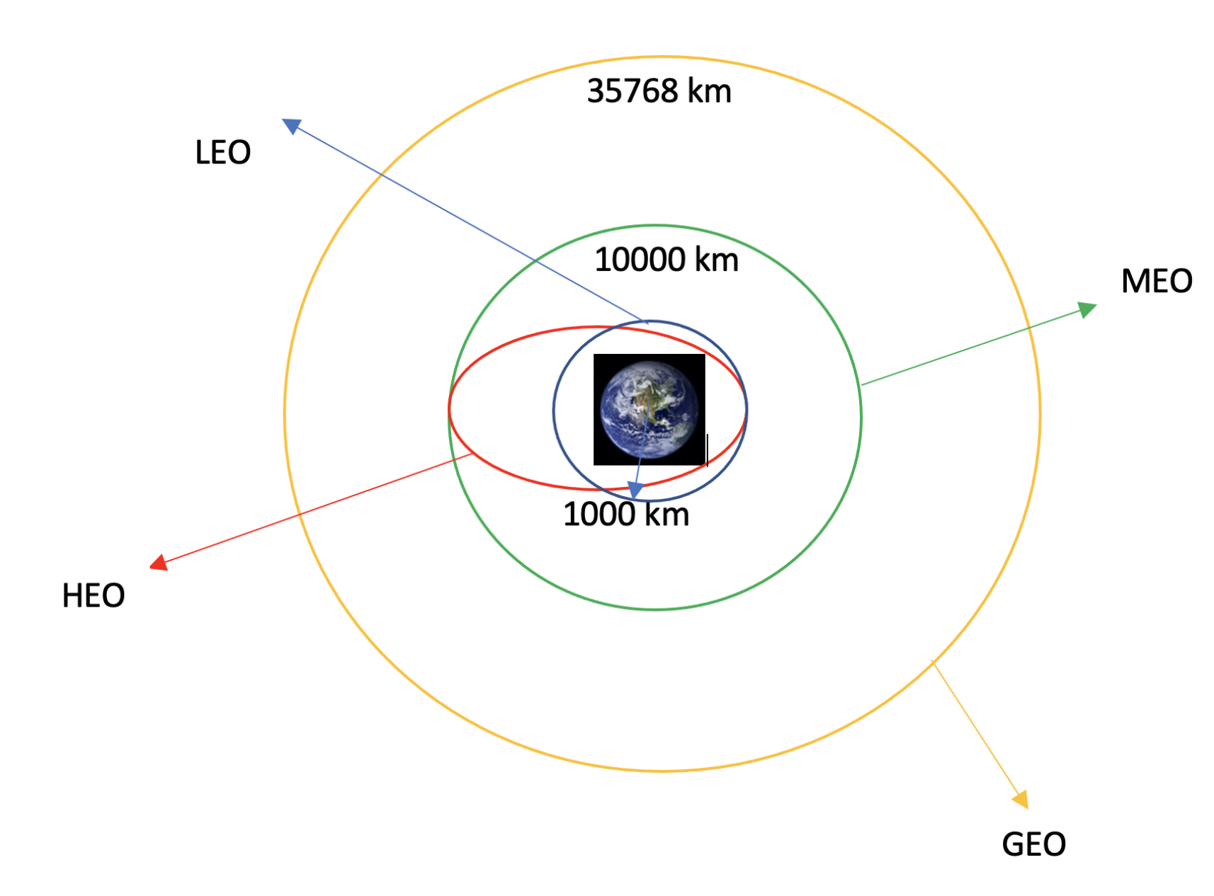
Data Wrangling
We performed exploratory data analysis and determined the training labels.
We calculated the number of launches at each site, and the number and occurrence of each orbits
We created landing outcome label from outcome column and exported the results to csv.
Github Link

Slide 11
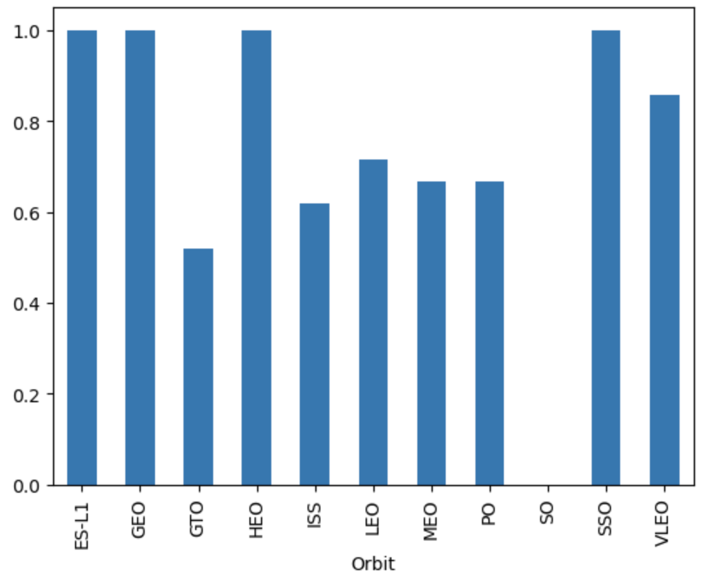
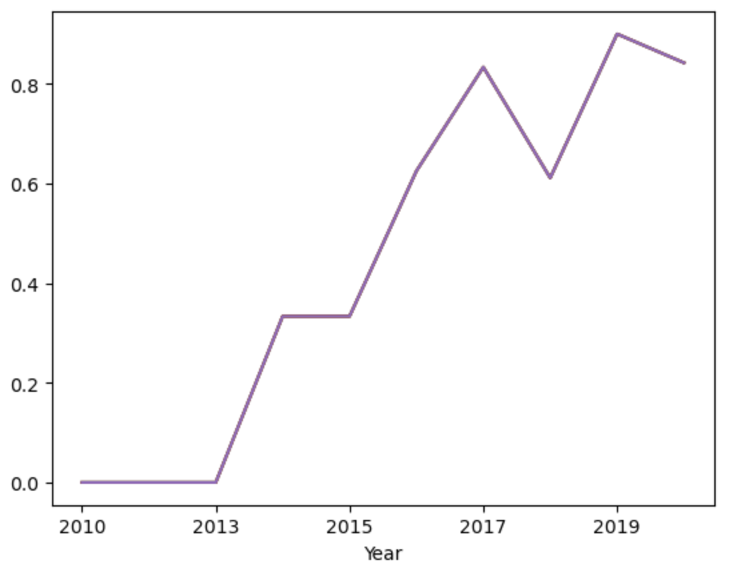
EDA with Data Visualization
We explored the data by visualizing the relationship between flight number and launch Site, payload and launch site, success rate of each orbit type, flight number and orbit type, the launch success yearly trend.
Github Link

Slide 12

EDA with SQL
We loaded the SpaceX dataset into a PostgreSQL database without leaving the jupyter notebook.
We applied EDA with SQL to get insight from the data. We wrote queries to find out for instance:
The names of unique launch sites in the space mission.
The total payload mass carried by boosters launched by NASA (CRS)
The average payload mass carried by booster version F9 v1.1
The total number of successful and failure mission outcomes
The failed landing outcomes in drone ship, their booster version and launch site names.
Github Link

Slide 13
Build an Interactive Map with Folium
We marked all launch sites, and added map objects such as markers, circles, lines to mark the success or failure of launches for each site on the folium map.
We assigned the feature launch outcomes (failure or success) to class 0 and 1.i.e., 0 for failure, and 1 for success.
Using the color-labeled marker clusters, we identified which launch sites have relatively high success rate.
We calculated the distances between a launch site to its proximities. We answered some question for instance:
Are launch sites near railways, highways and coastlines.
Do launch sites keep certain distance away from cities.
Github Link

Slide 14
Build a Dashboard with Plotly Dash
We built an interactive dashboard with Plotly dash
We plotted pie charts showing the total launches by a certain sites
We plotted scatter graph showing the relationship with Outcome and Payload Mass (Kg) for the different booster version.
Github Link

Slide 15
Predictive Analysis (Classification)
We loaded the data using numpy and pandas, transformed the data, split our data into training and testing.
We built different machine learning models and tune different hyperparameters using GridSearchCV.
We used accuracy as the metric for our model, improved the model using feature engineering and algorithm tuning.
We found the best performing classification model.
Github Link

Slide 16

Section 2

Slide 17
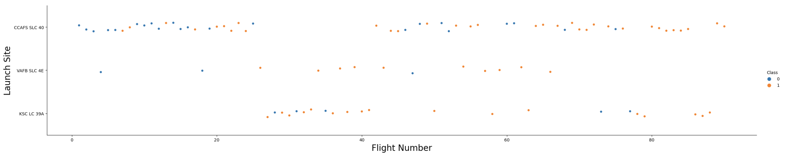
Flight Number vs. Launch Site
From the plot, we found that SpaceX progressively became more successful with more attempts over time.

Slide 18
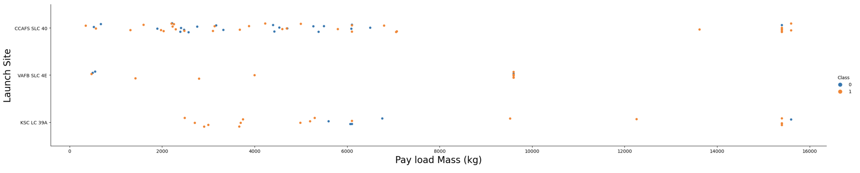
From the plot, we discovered that generally, heavier payload mass resulted in a higher rate of success.
Payload vs. Launch Site

Slide 19
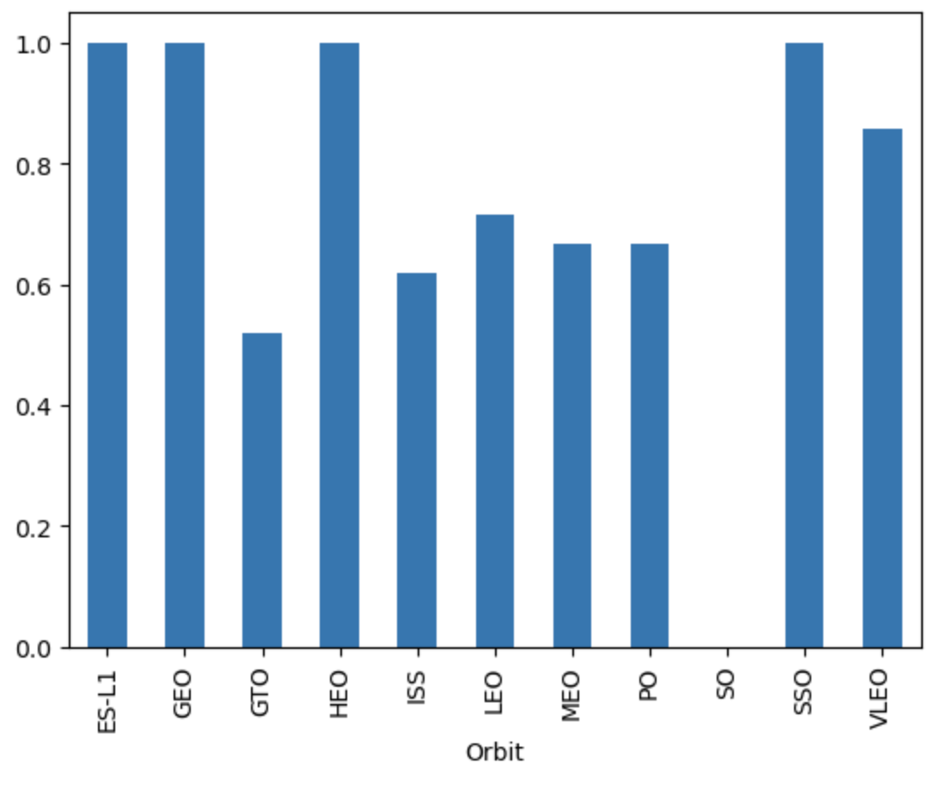
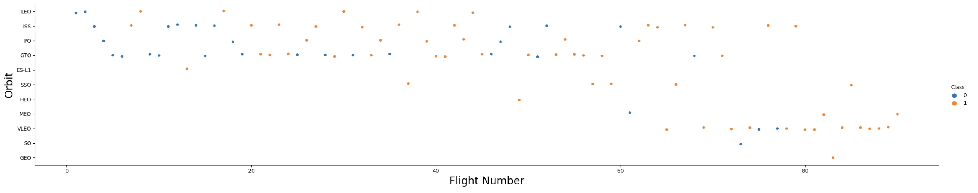
Success Rate vs. Orbit Type
While we can see that SSO, HEO, GEO and ES-L1 orbits had the highest rates of success, it is also true that their sample sizes were of the smallest, totaling 8 launches. Notable is VLEO, which was successful in 12 out of 14 launches. It is also difficult to discern a pattern for GTO and ISS.

Slide 20
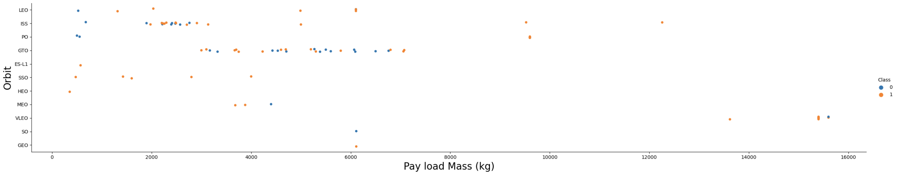
Payload vs. Orbit Type
It appears heavier payloads are correlated to higher success rates for LEO, ISS, and Polar, while GTO is indistinguishable of a patter of success or failure.

Slide 21
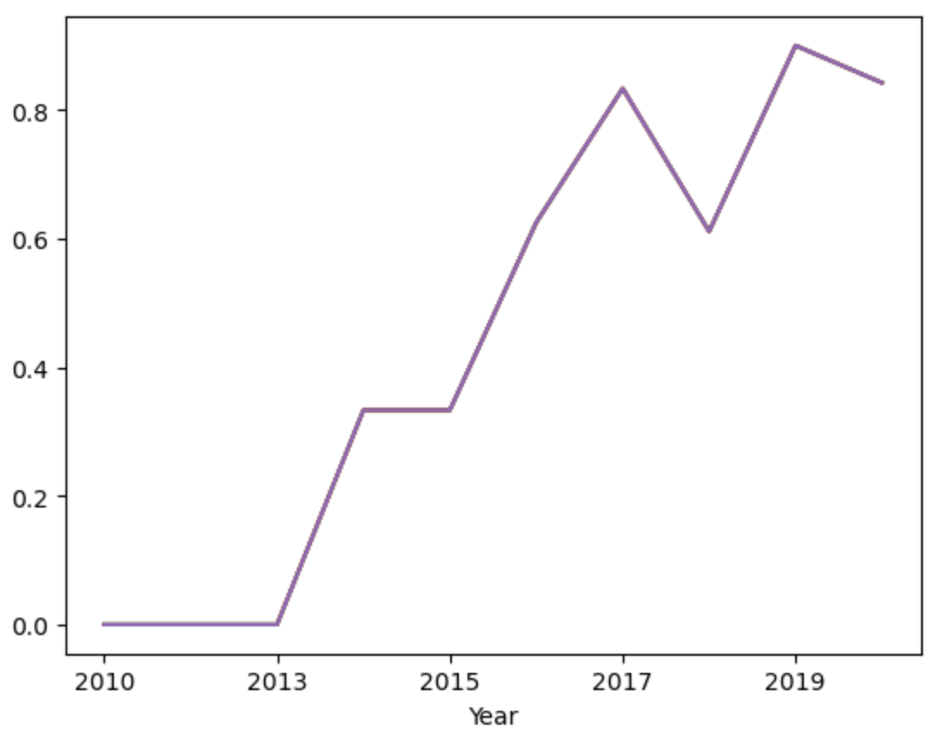
Launch Success Yearly Trend
As SpaceX progressed and learned from their mistakes, their rate of success continued to increase, surpassing a success rate of 60% in 2016 and not dropping below that rate since.

Slide 22
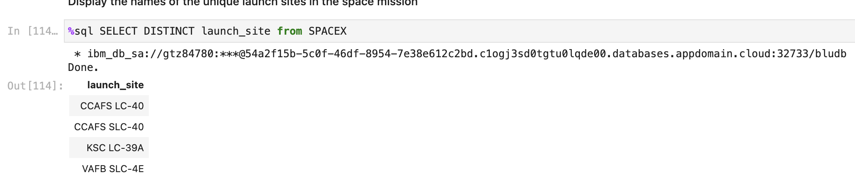
All Launch Site Names
Using SQL, I found the different launch sites
CCAFS LC-40 (Cape Canaveral Launch Complex 40)
CCAFS SLC-40 (Cape Canaveral Space Launch Complex 40)
KSC LC-39A (Kennedy Space Center Launch Complex 39A)
VAFB SLC-4E (Vandenberg Space Launch Complex 4E)

Slide 23
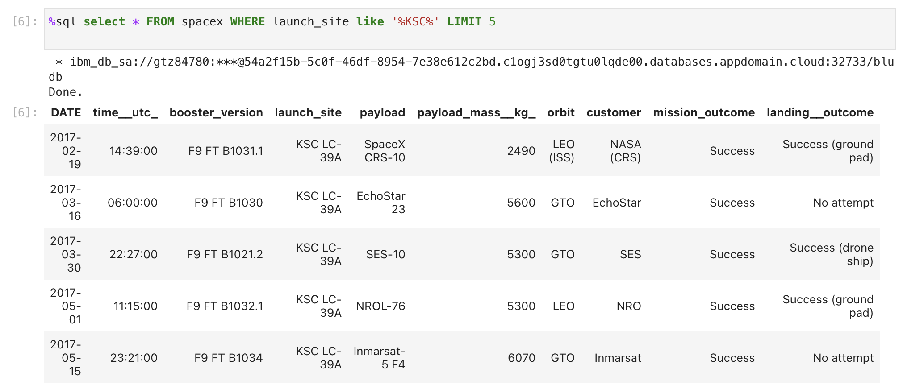
Launch Site Names Begin with 'KSC'
We used the query to display 5 records where the launch site was at KSC LC-39A.

Slide 24
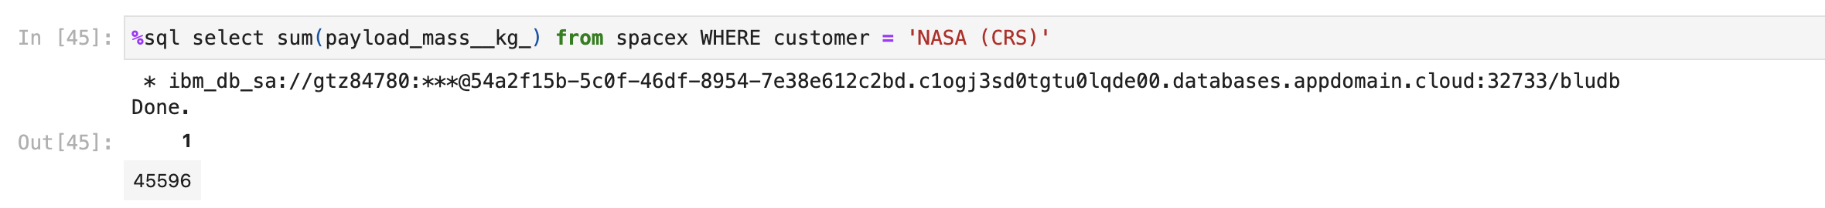
Total Payload Mass
Using SQL, we discovered that the total payload by boosters from NASA was 45,596.

Slide 25
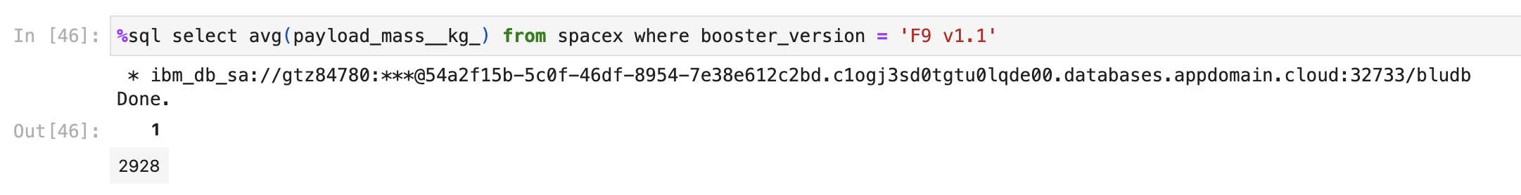
Average Payload Mass by F9 v1.1
Then we discovered using the query that the average payload mass carried by booster version F9 V1.1 was 2,928.4.

Slide 26
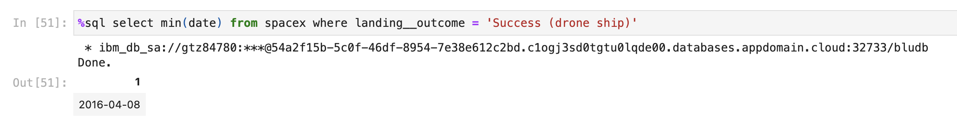
First Successful Ground Landing Date
Here we discovered that the first successful ground landing by drone stop was on April 8th, 2016.

Slide 27
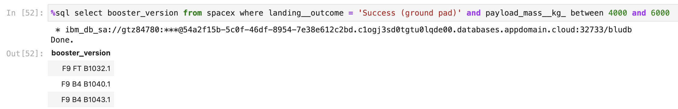
Successful Ground Pad Landing with Payload between 4000 and 6000
Using SQL, we filtered the data to show the booster versions that had successful ground pad landings with payload masses between 4000 and 6000 kg. They were:
F9 FT B1032.1
F9 B4 B1040.1
F9 B4 B1043.1

Slide 28
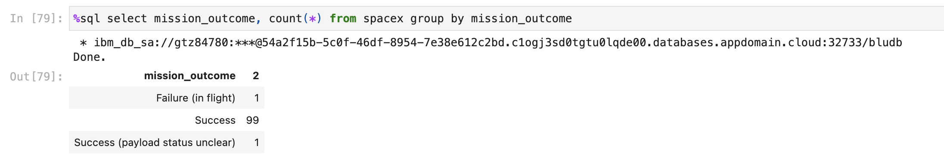
Total Number of Successful and Failure Mission Outcomes
Overall, from our data we discovered that there were 100 total successful mission outcomes and only 1 failure in flight.

Slide 29
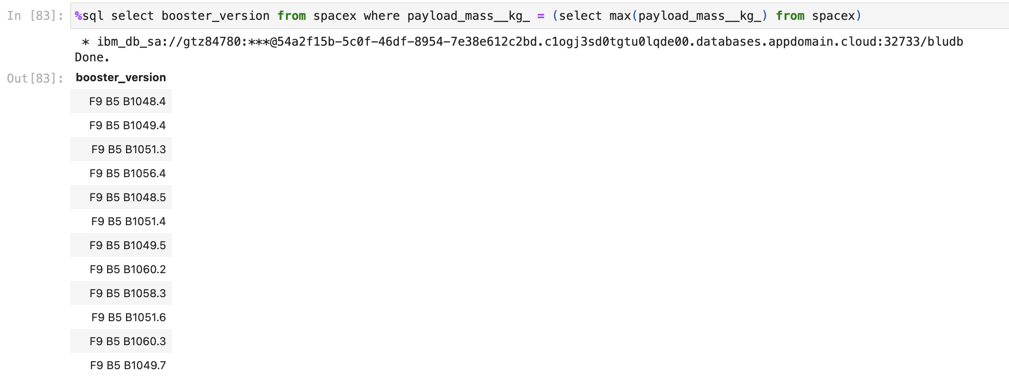
Boosters Carried Maximum Payload
Using the query, we filtered the data to discover the booster version that had the maximum payload.

Slide 30
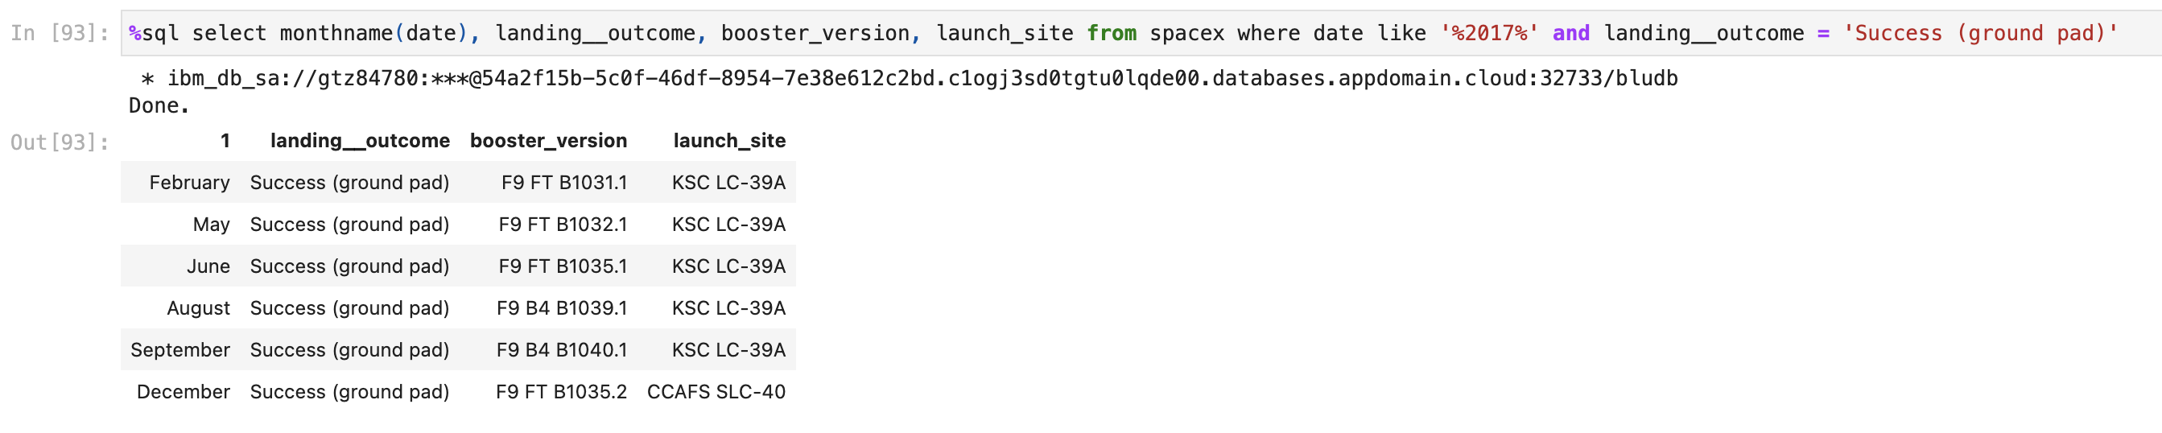
2017 Launch Records
Here we filtered the data to display the month, booster version, and launch site of successful landings in 2017.

Slide 31
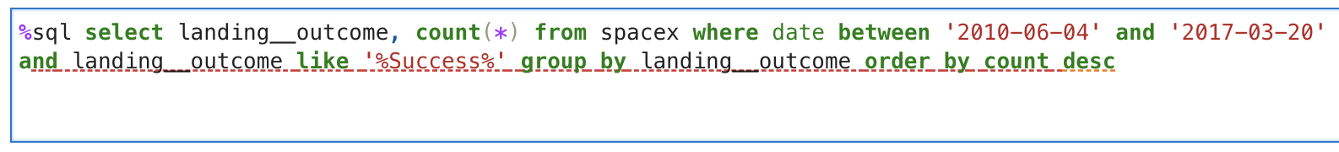
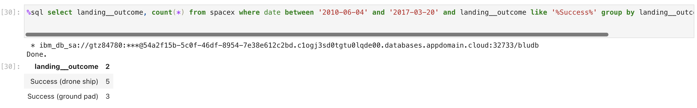
Rank Landing Outcomes Between 2010-06-04 and 2017-03-20
Lastly, we ranked the successful landing outcomes from June 4th, 2010 and March 20th, 2017. As we can see, there were more successful landing outcomes via drone ship than ground pad between these dates.

Slide 32

Section 3

Slide 33

Launch Sites on a Global Map

Slide 34
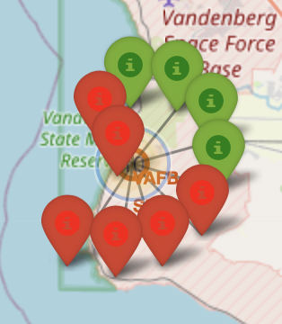
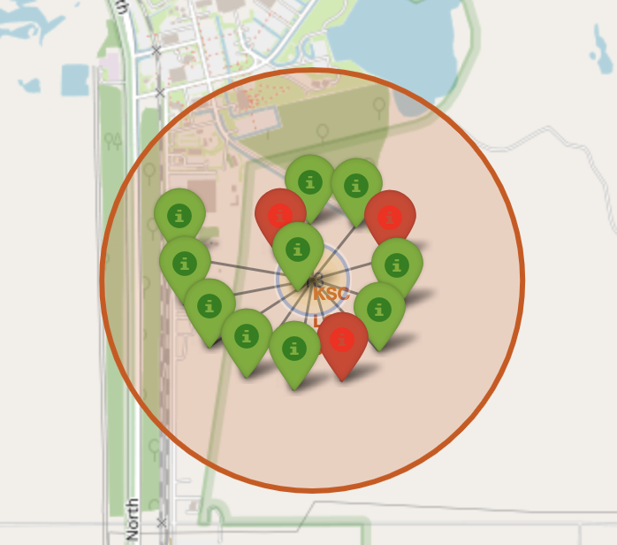
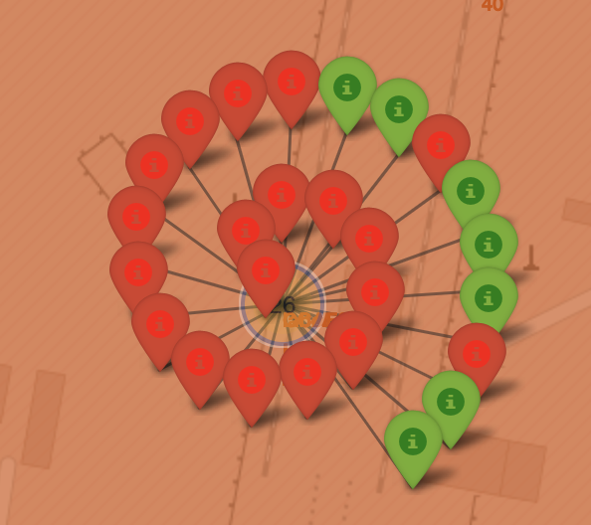
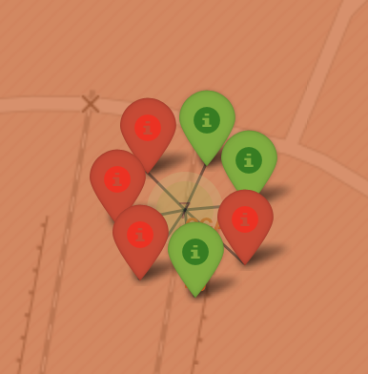
Launch Sites with Success vs Failure Launches
Vandenberg
Kennedy Space Center
Cape Canaveral LC-40
Cape Canaveral SLC-40
On the map, we created markers to depict successful (green) and failure (red) launches.

Slide 35
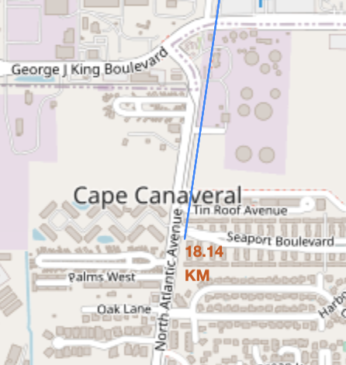
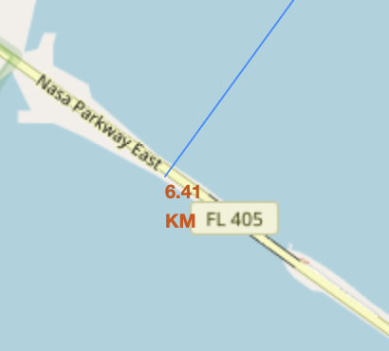
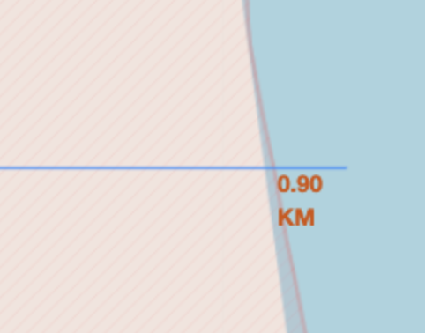
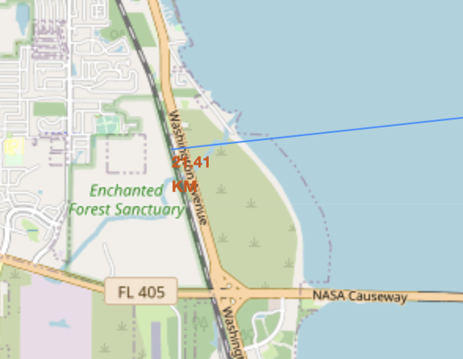
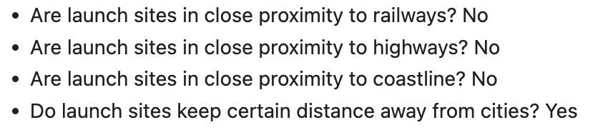
Launch Site Distance to Landmarks

Slide 36

Section 4

Slide 37
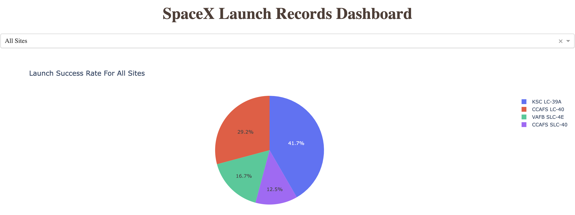
Total Success Launches by All Sites
As we can see, Kennedy Space Center had the most successful launches.

Slide 38
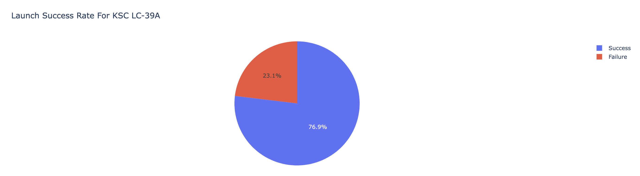
Kennedy Space Center Success Rate
At Kennedy Space Center, there was a 76.9% rate of success and a 23.1% rate of failure.

Slide 39
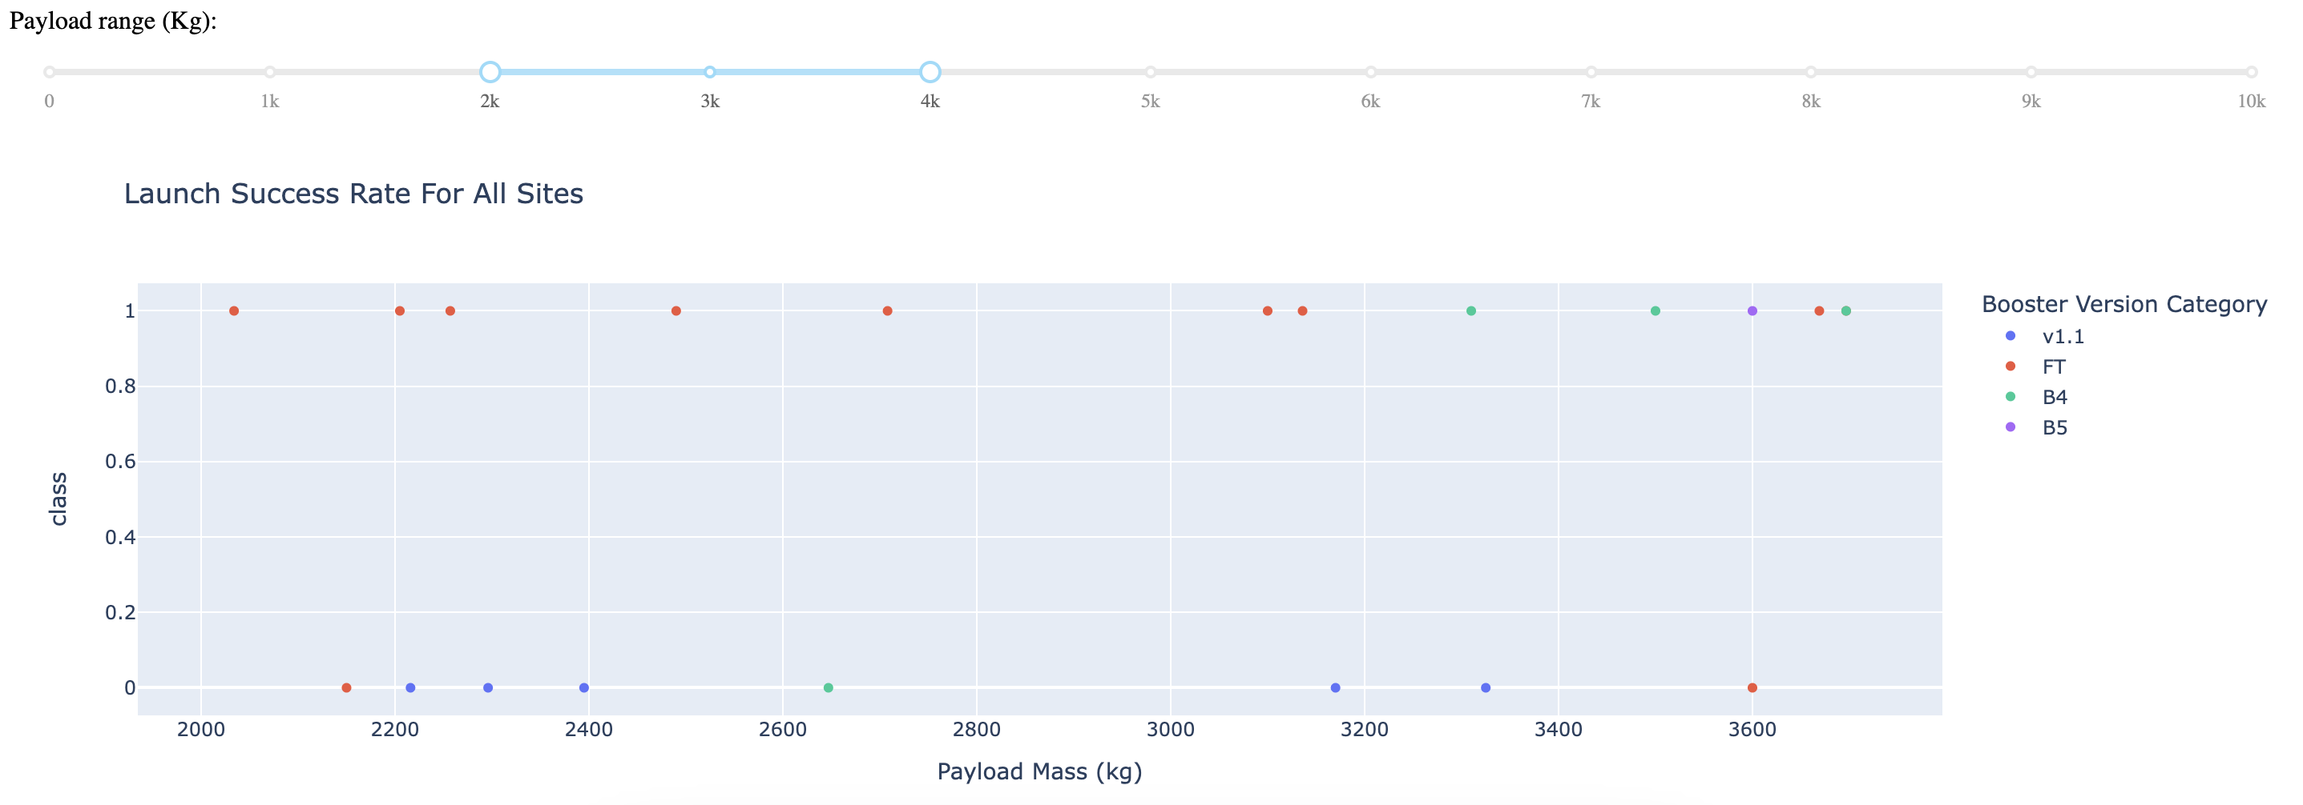
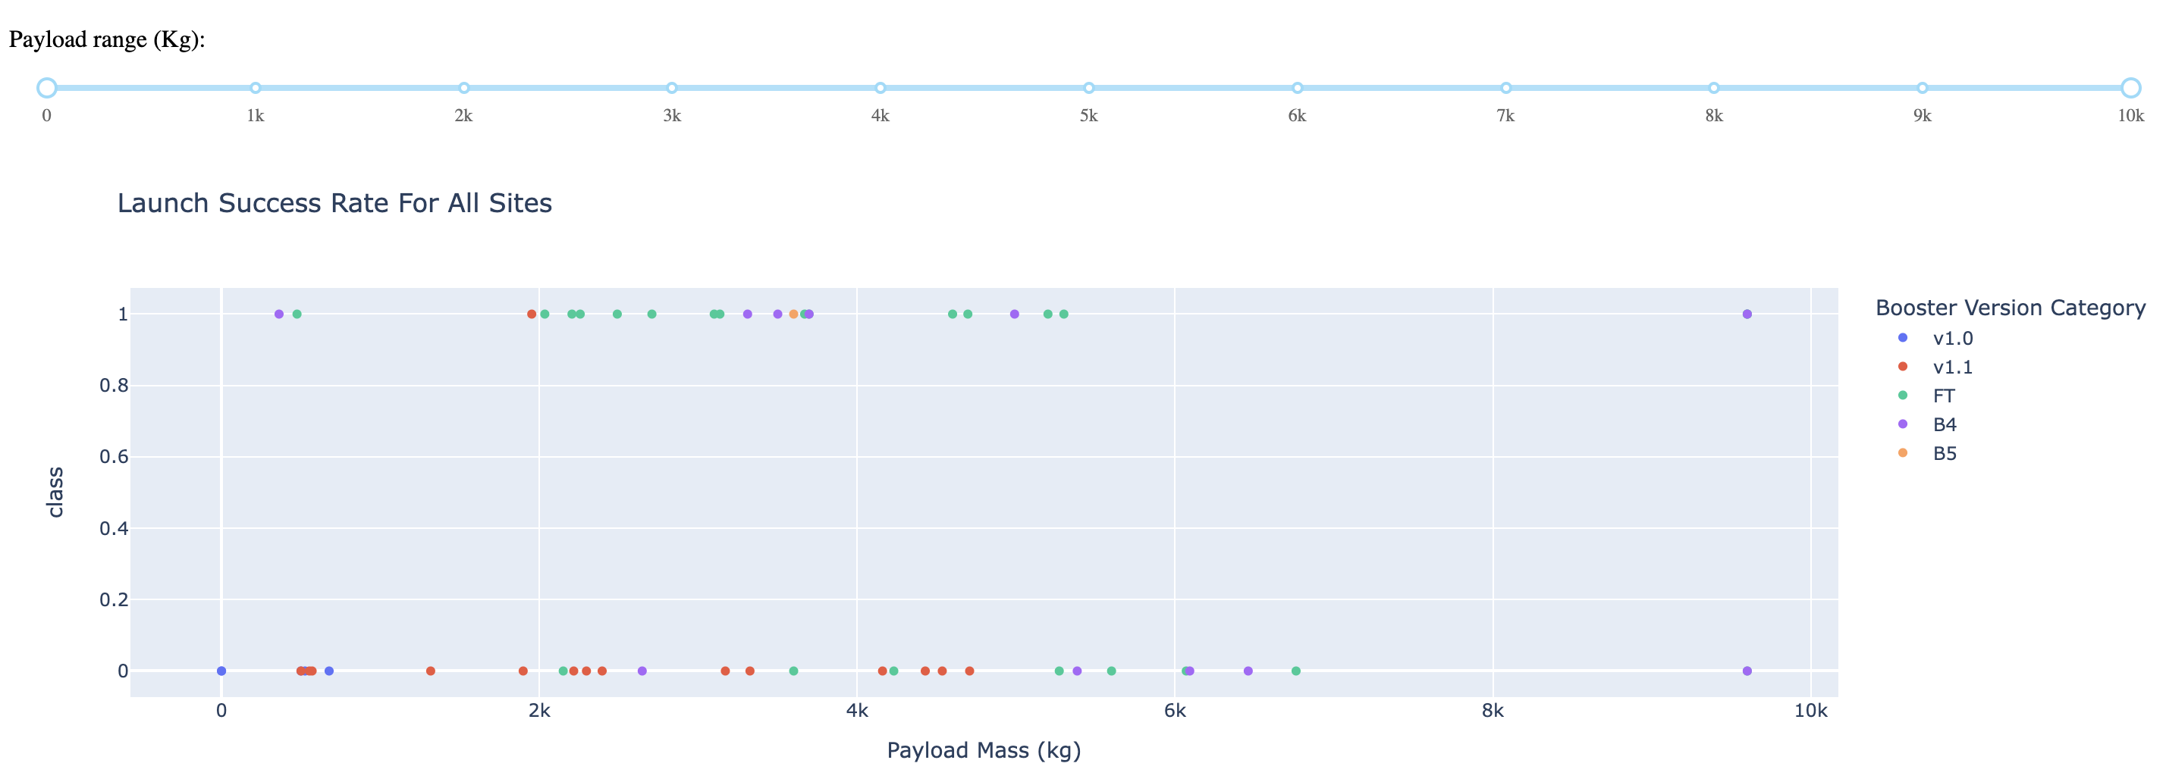
Scatterplot for Success Rates for Booster Versions
By analyzing the scatterplot, it appears that the highest rate of success with booster FT was between 2000 and 4000 kg for payload mass.

Slide 40

Section 5

Slide 41
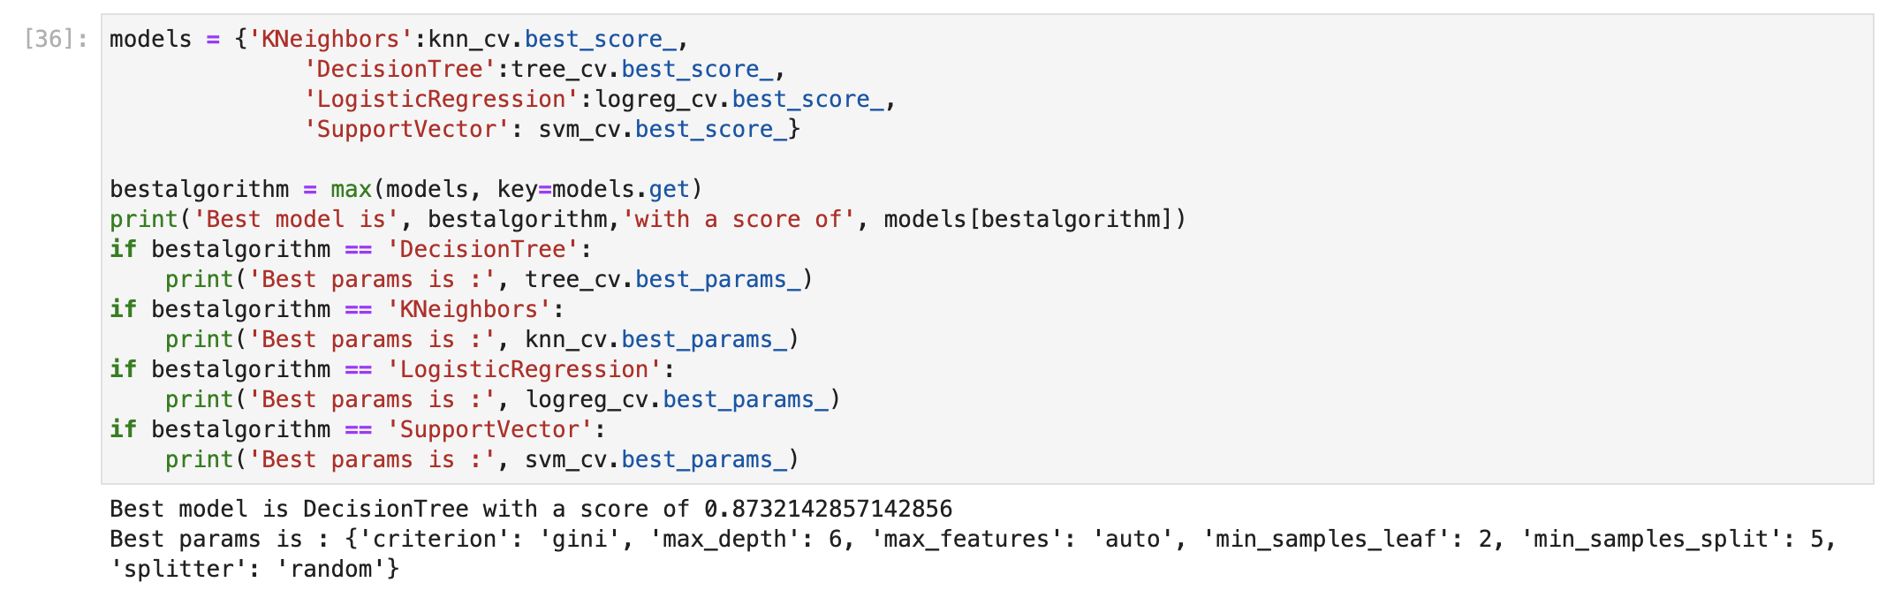
Classification Accuracy
By analyzing the predictive models, I concluded that the Decision Tree was the most accurate model.

Slide 42
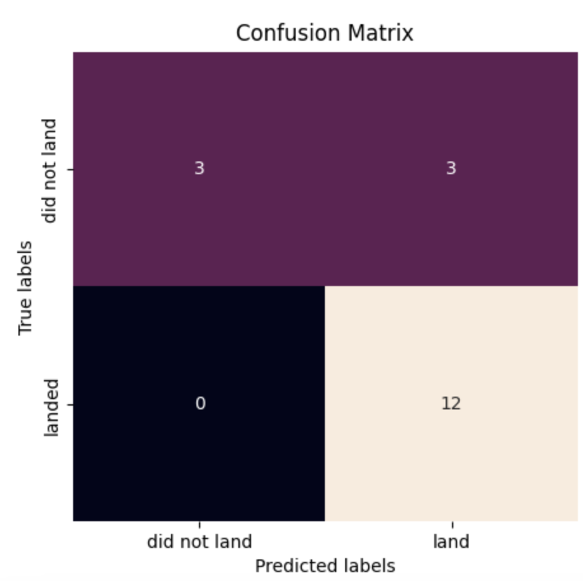
Confusion Matrix
The confusion matrix for the decision tree classifier shows that the classifier can distinguish between the different classes. The major problem is the false positives .i.e., unsuccessful landing marked as successful landing by the classifier.

Slide 43
Conclusions
We can conclude that:
The larger the flight amount at a launch site, the greater the success rate at a launch site.
Launch success rate started to increase in 2013 till 2020.
Orbits ES-L1, GEO, HEO, SSO, VLEO had the most success rate.
Booster FT between 2000 and 4000 kg had the highest success rate.
KSC LC-39A had the most successful launches of any sites.
The Decision tree classifier is the best machine learning algorithm for this task.

Slide 44


